Slide 1
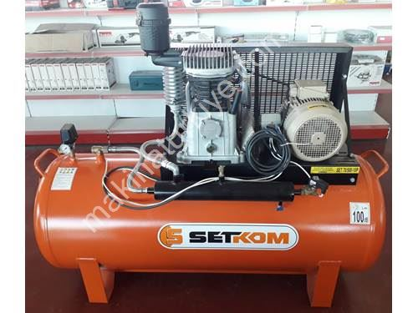
MECH203 TERM PROJECT Aır Compressor
Ahmet Mete Coşkun
EmIr Kaan Sonay
ErkIn Püren
HIkmet Batuhan Balkı
Mert Ayhan Tandoğdu
TA: bERKAY DEMIRYÜLEK

Slide 2

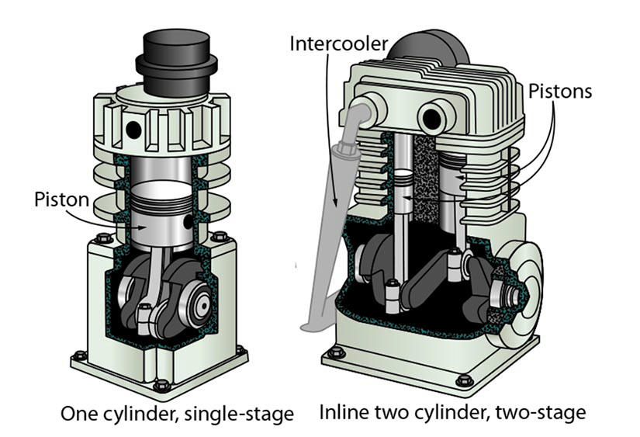
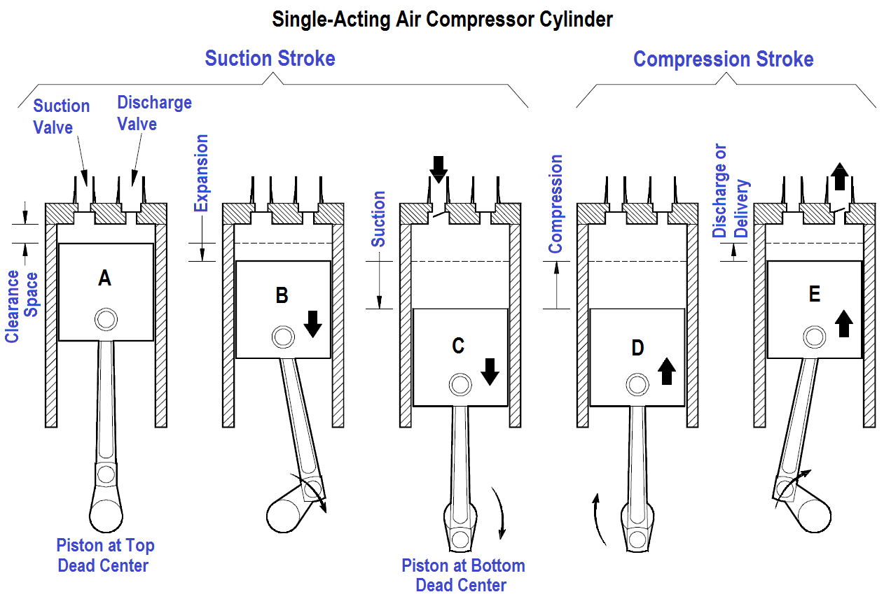
aIR COMPRESSOR
AIr compressors are machInes that store the outsIde aIr In the tank chamber and allow the formatIon of compressed aIr.
Compressed aIr In recIprocatIng compressors Is obtaIned as a result of compressIon of the aIr or gas by the forward and backward movement of the pIston.

Slide 3

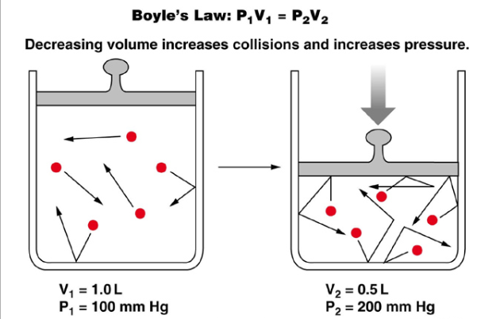
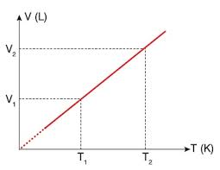
HOW DOES AN AIR COMPRESSOR WORK?
As more aIr Is pulled Into the aIr compressor, the pressure rIses as a result of the larger volume beIng forced Into a smaller space.
The workIng of aIr compressors Is based on the Boyle's law. Boyle's Law Is the volume and pressure of a gas of constant mass and constant temperature are Inversely proportIonal. In other words, as the pressure Increases, the volume decreases, and as the volume Increases, the pressure decreases. therefore producIng energy.

Slide 4
AT HOW many WATTS DOES AIR COMPRESSOR OPERATE and what are other measurements ?
the part that we acquIred was a second hand part and It was workIng In a system before. The orIgInal compressor had a tank wIth It but the tank was very bIg In sIze and ImpossIble to measure. WIth the tank the compressor Is 203 kg wIthout It , the compressor weIghs 15 kg. The compressor works In a range of 3.5 to 5.5 kWs. The compressor has Its materIals mostly made out of an alumInIum alloy, the parts that are responsIble for sealIng are made out of plastIc. The compressor can apply pressure up to 11 bars. And the flow Is 653 lItres per mInute.

Slide 5
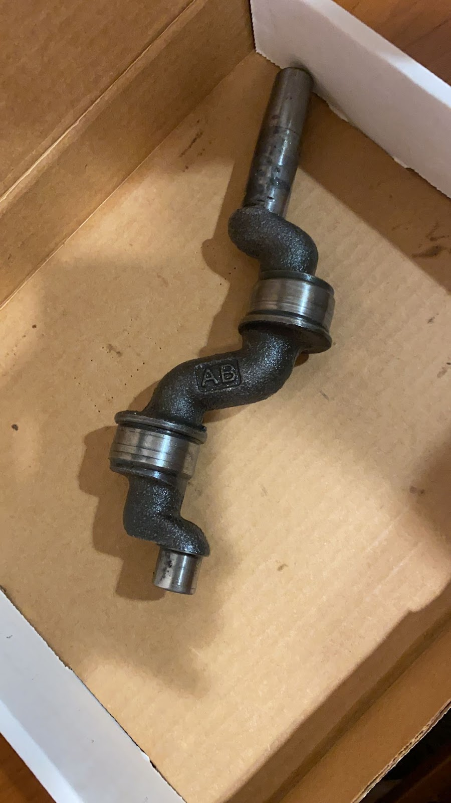
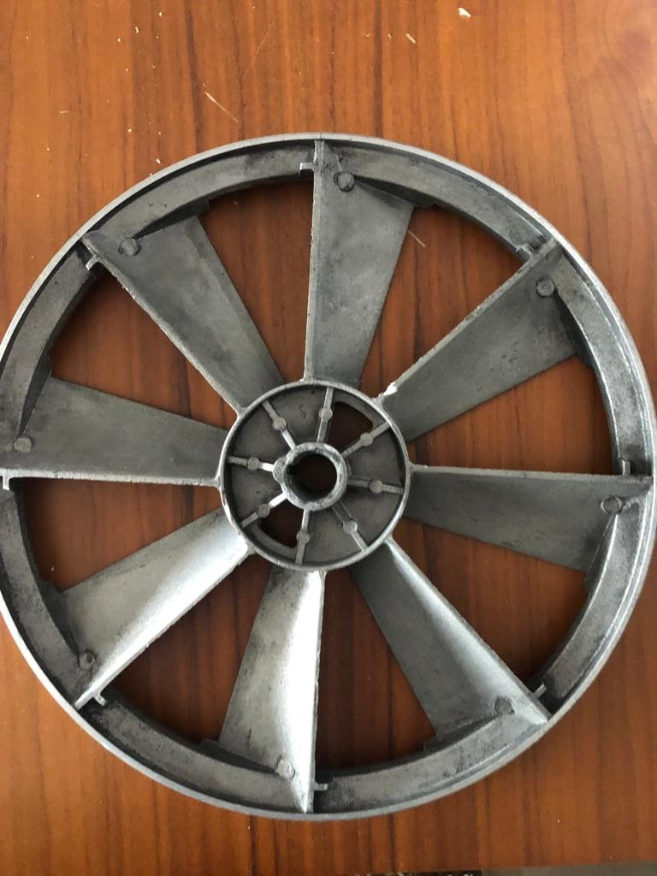
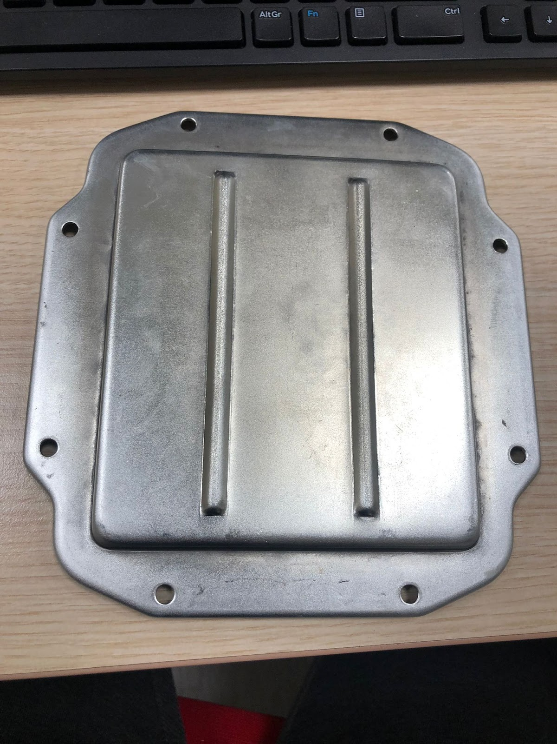
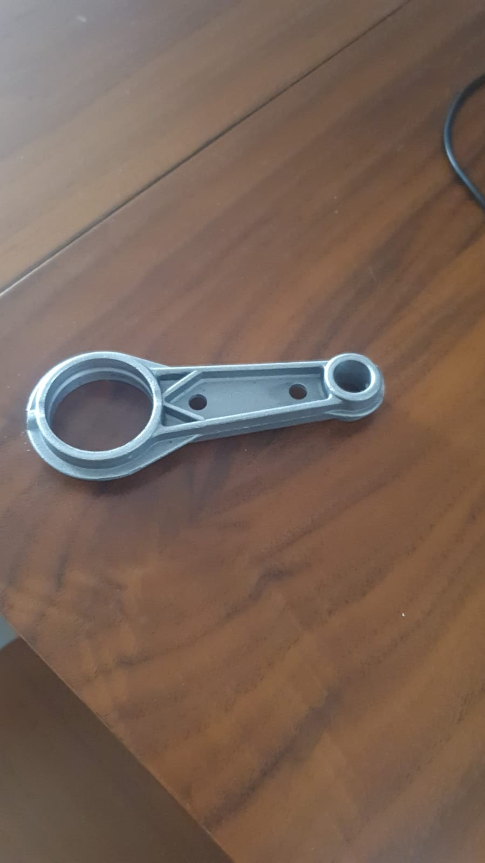
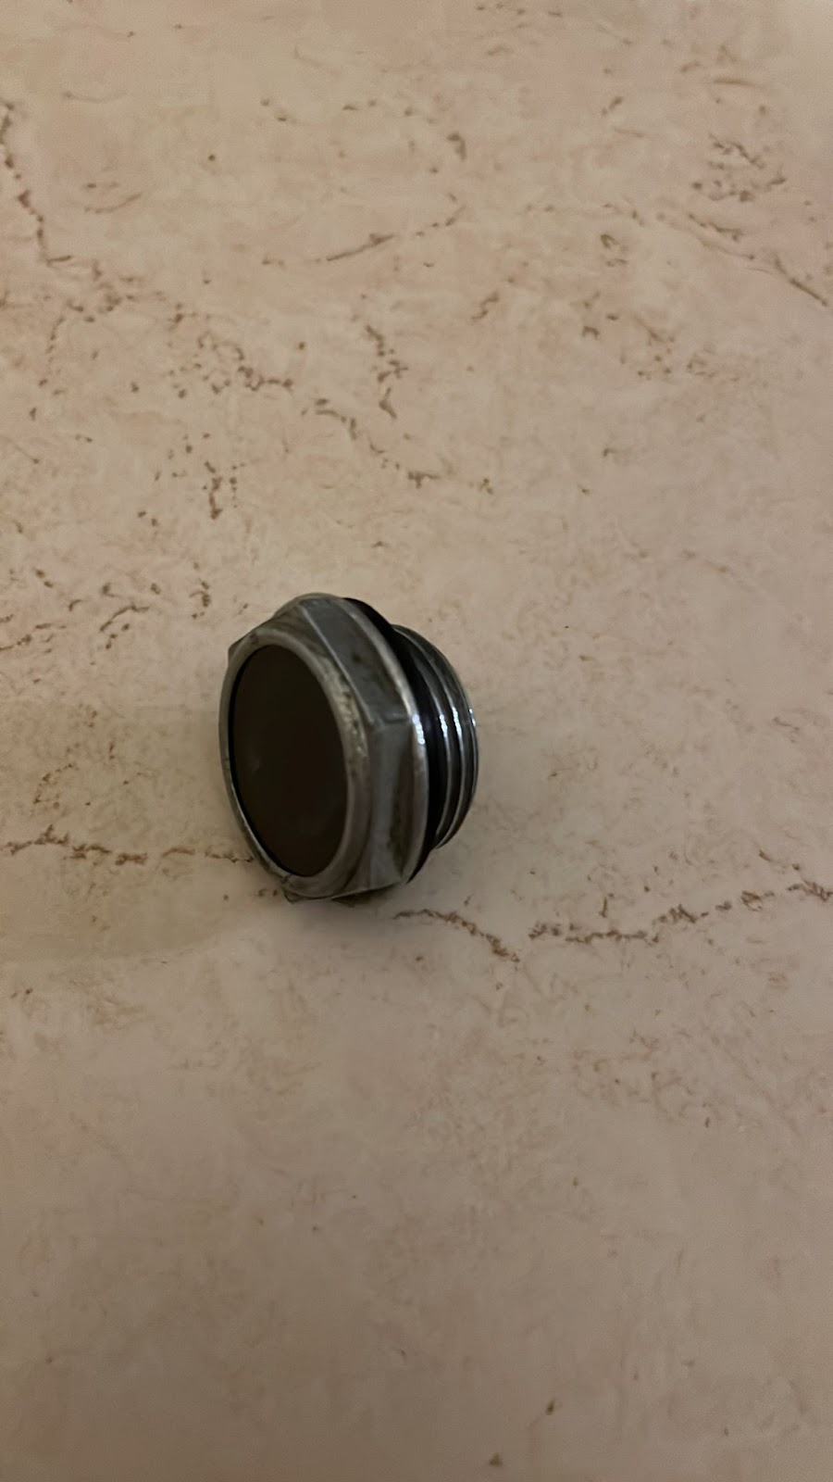
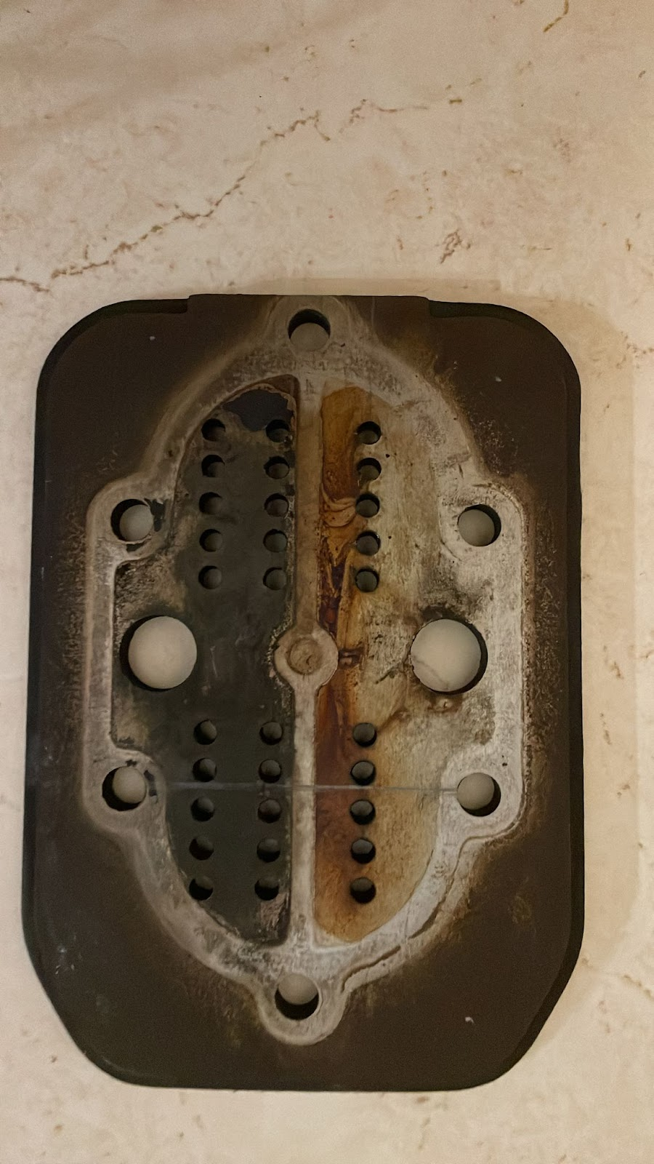
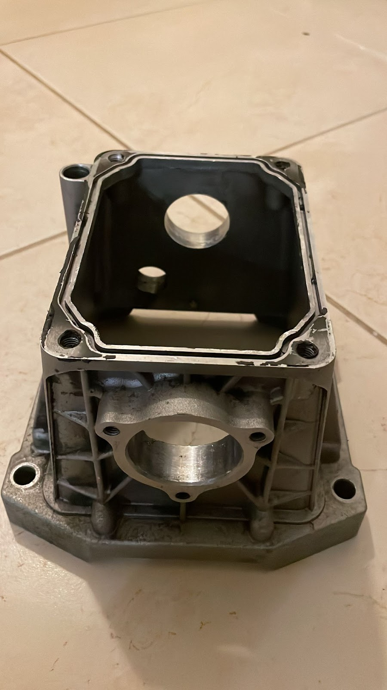
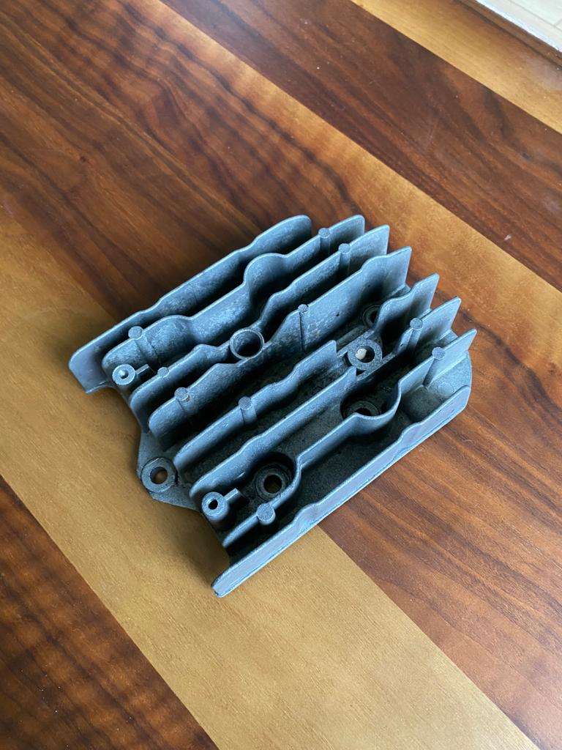
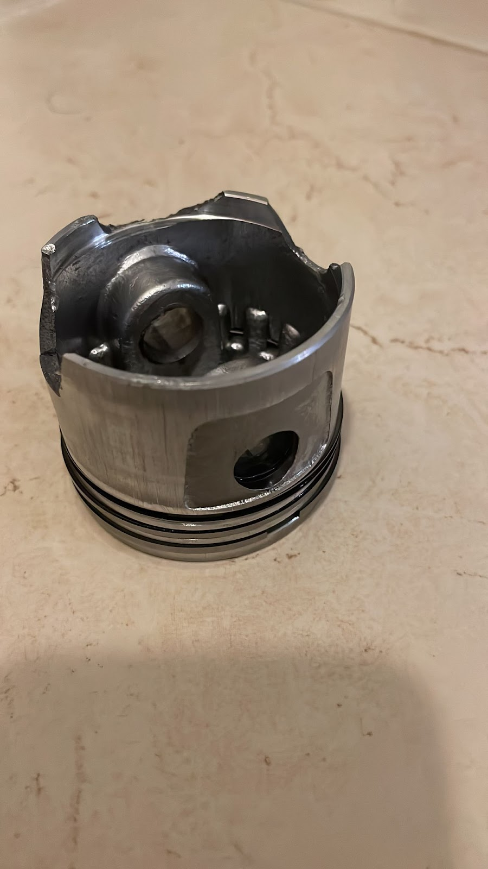
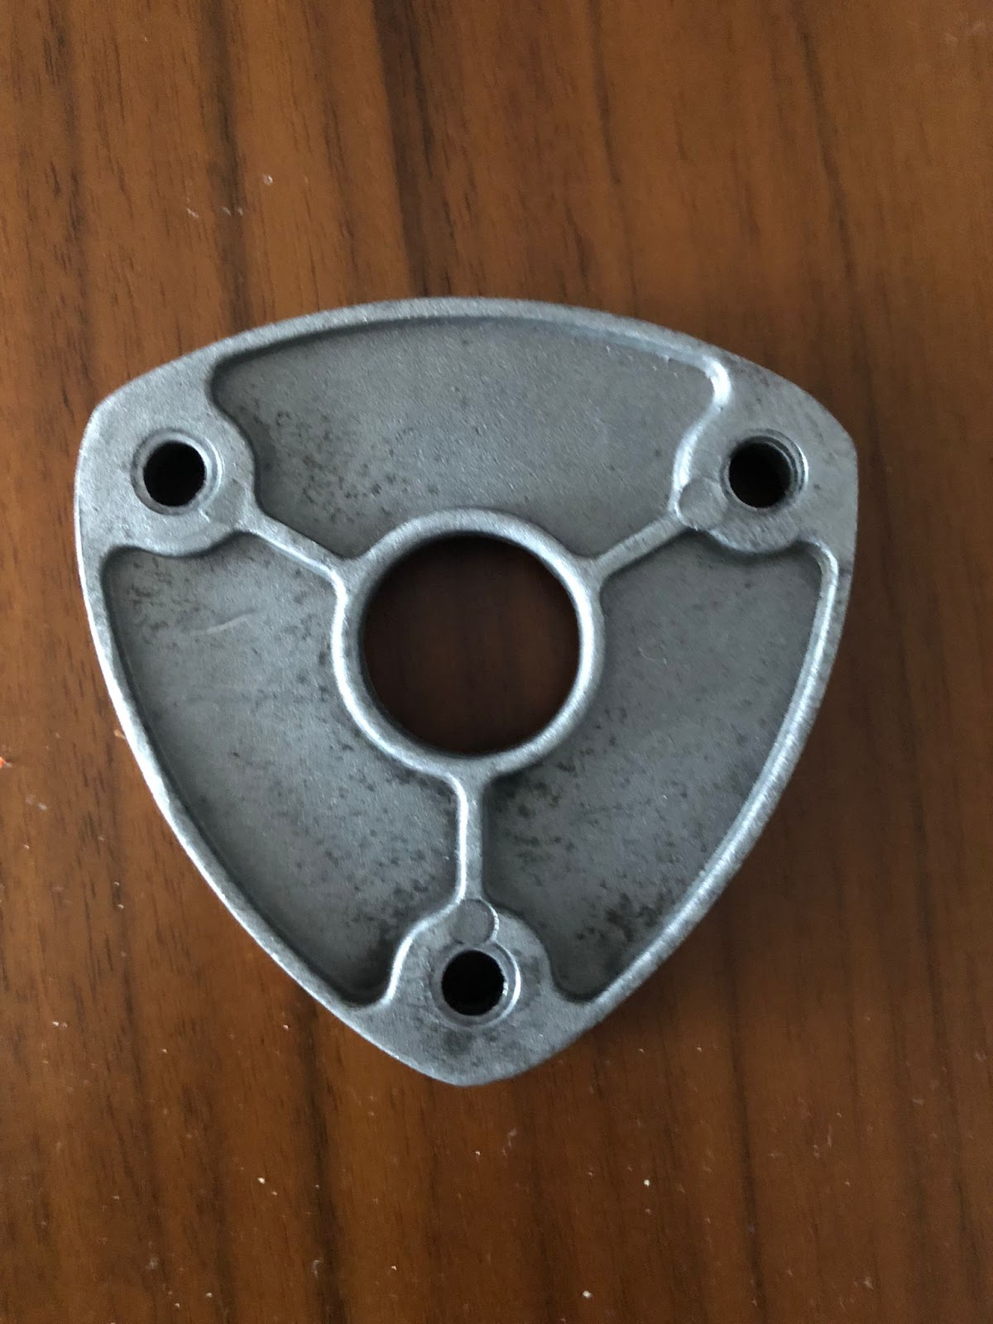
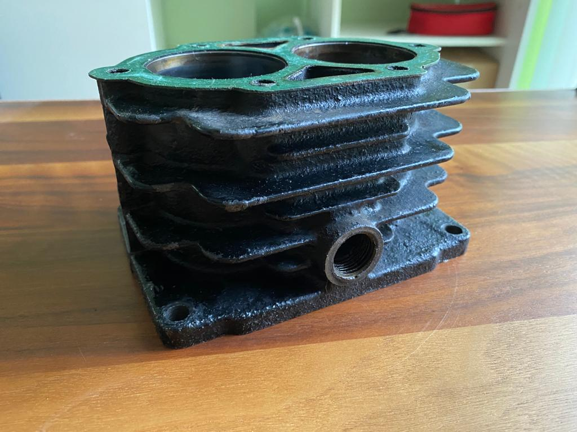
Parts aND dISASEMBLY
The object contaIns 33 parts.
We have put over 120 hours to complete the modellIng pocess.
ıt took 3 hours to dIssassemblE and 6 hours to assemblE.

Slide 6

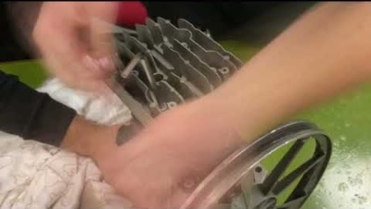
DIsassembly

Slide 7
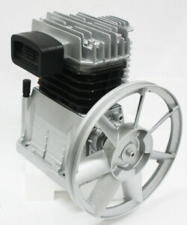
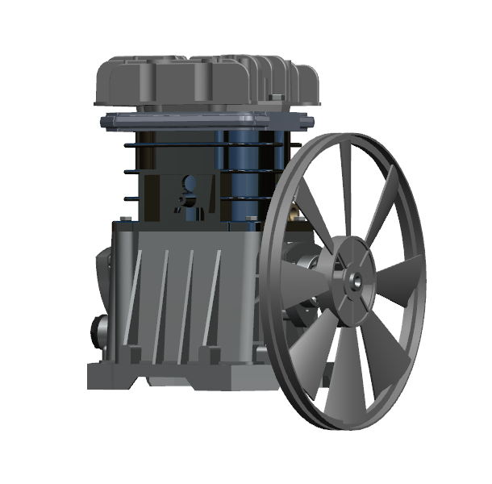
Our object IN REAL life
Our finished and Rendered assembly

Slide 8
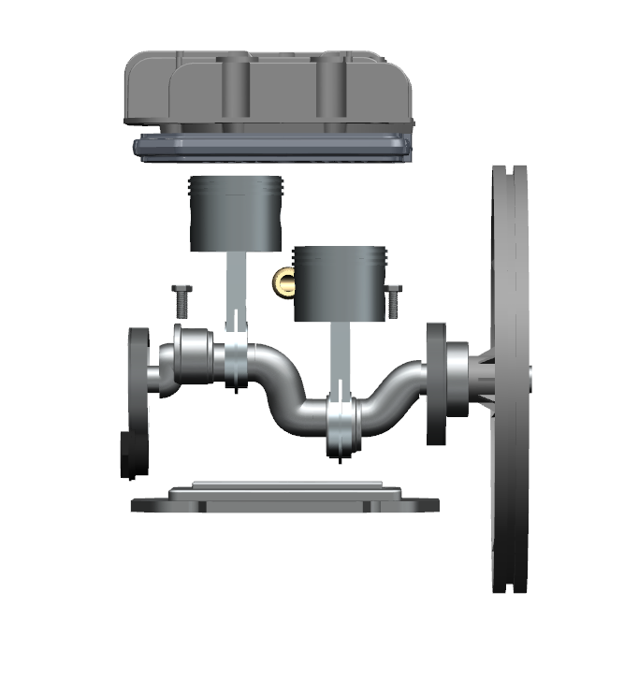
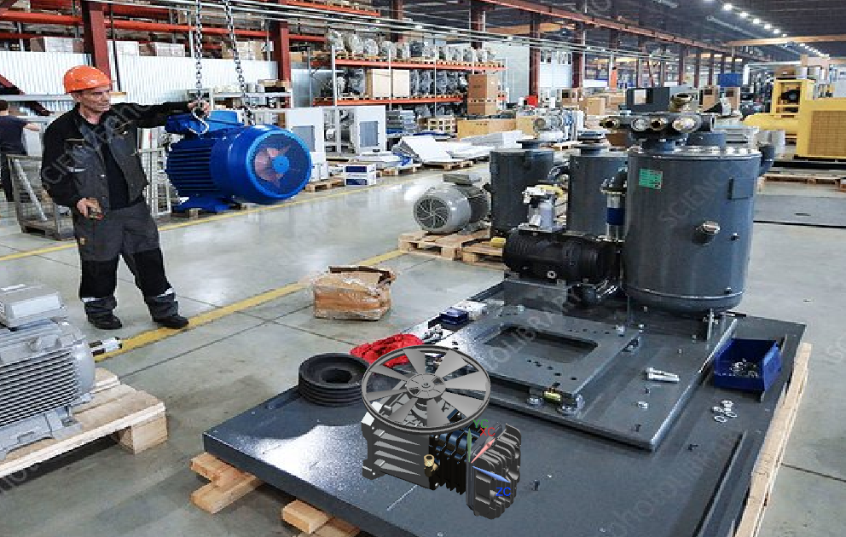

Slide 9
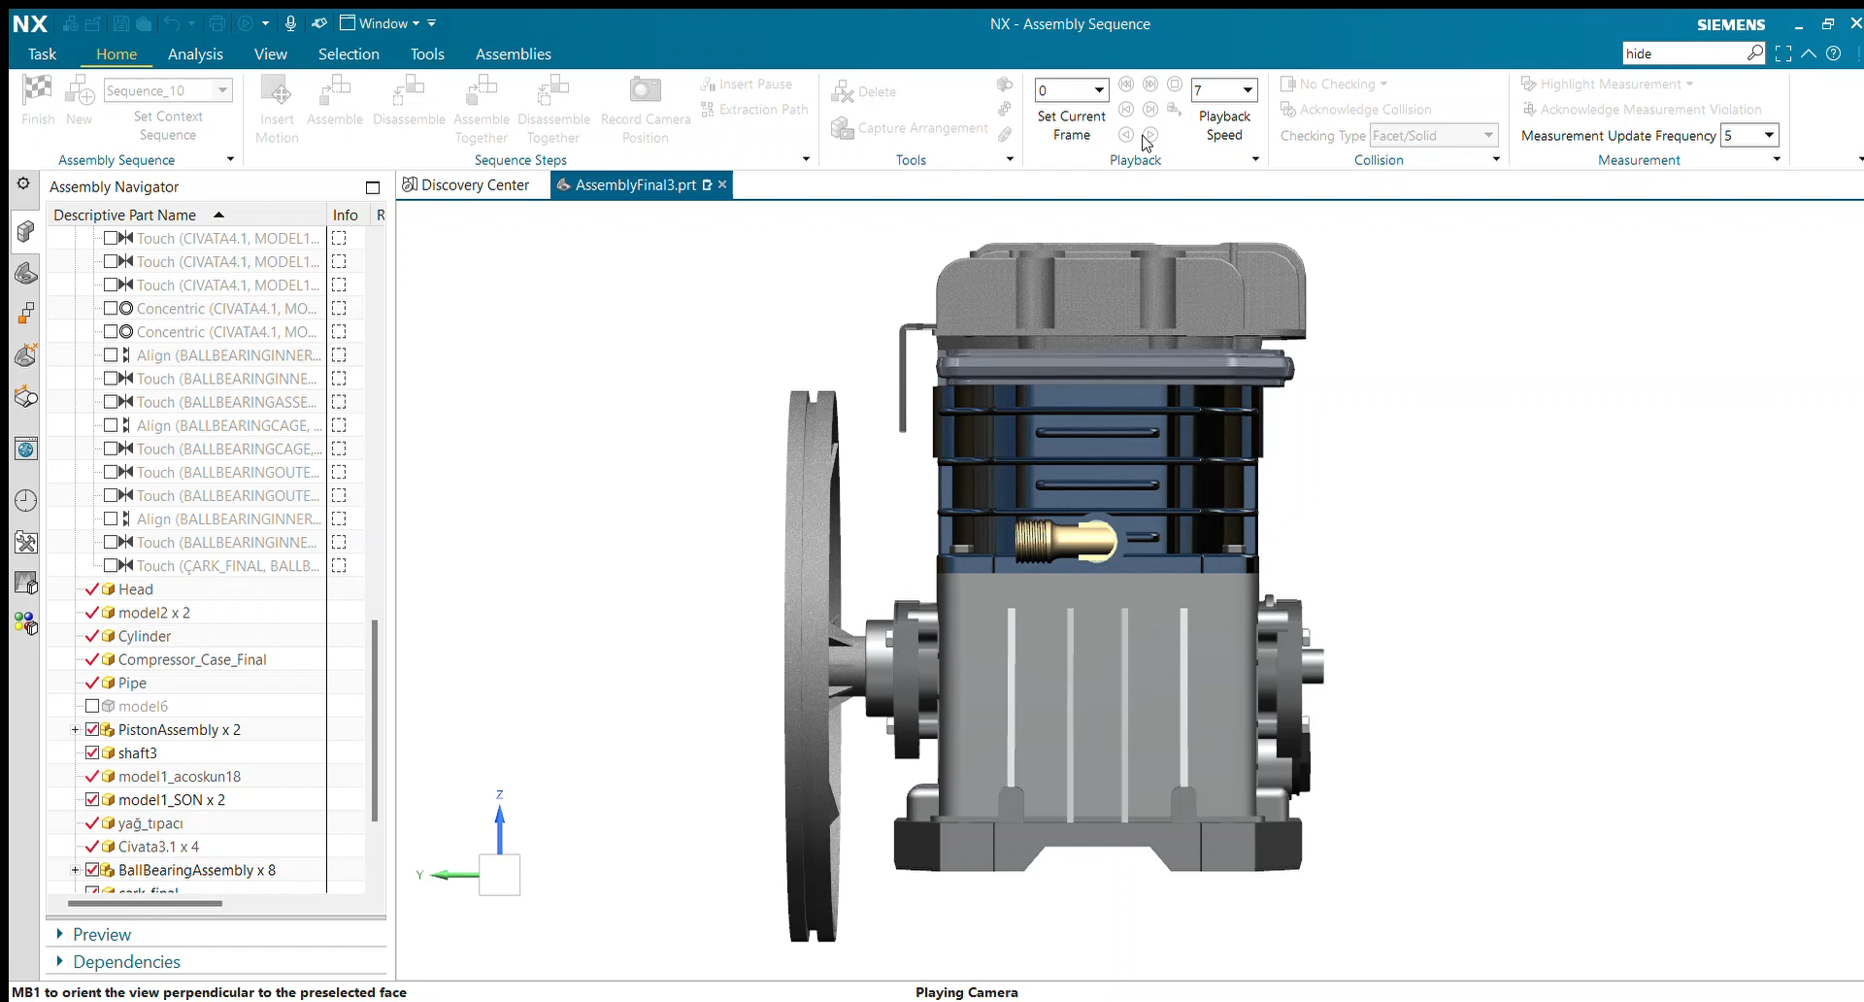
Assembly sequence

Slide 10
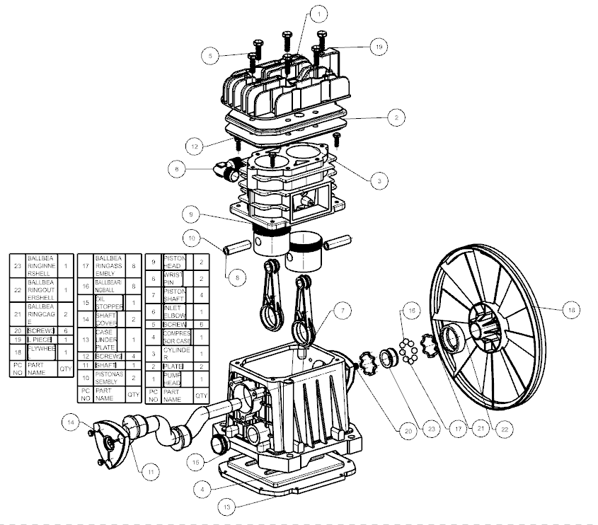

Slide 11
DIFFICULTIES THAT WE FACED
SInce the aIr compressor we used was second hand, some parts were rusty and stuck, so we had a dIffIculty In dIsassemblIng It.
Some pIeces were too small to measure wIth a calIper.
We trIed to communIcate vIa Zoom as we were apart durIng the assembly and dIsassembly.
We had some problems because one of our frIends left the group and she dId It In the last mInute. Some of the components were not gIven back by her so we lost some tIme whIle tryIng to replace the parts

Slide 12
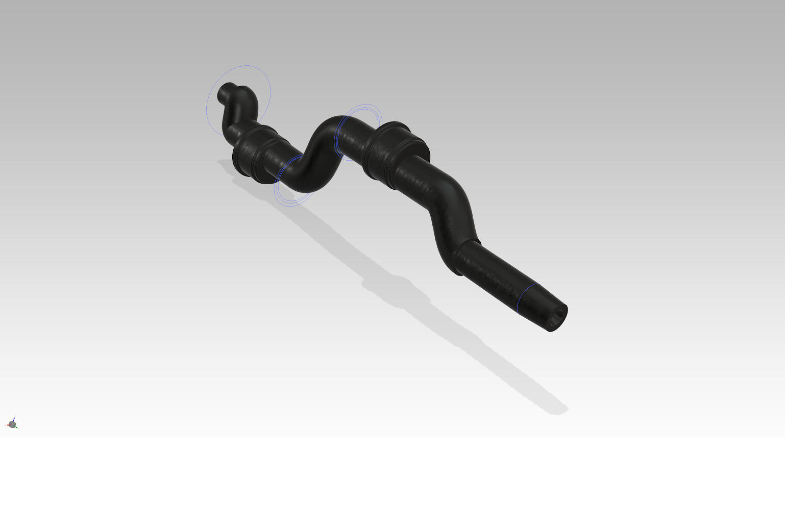
MODEL BY: EMİR KAAN SONAY

Slide 13
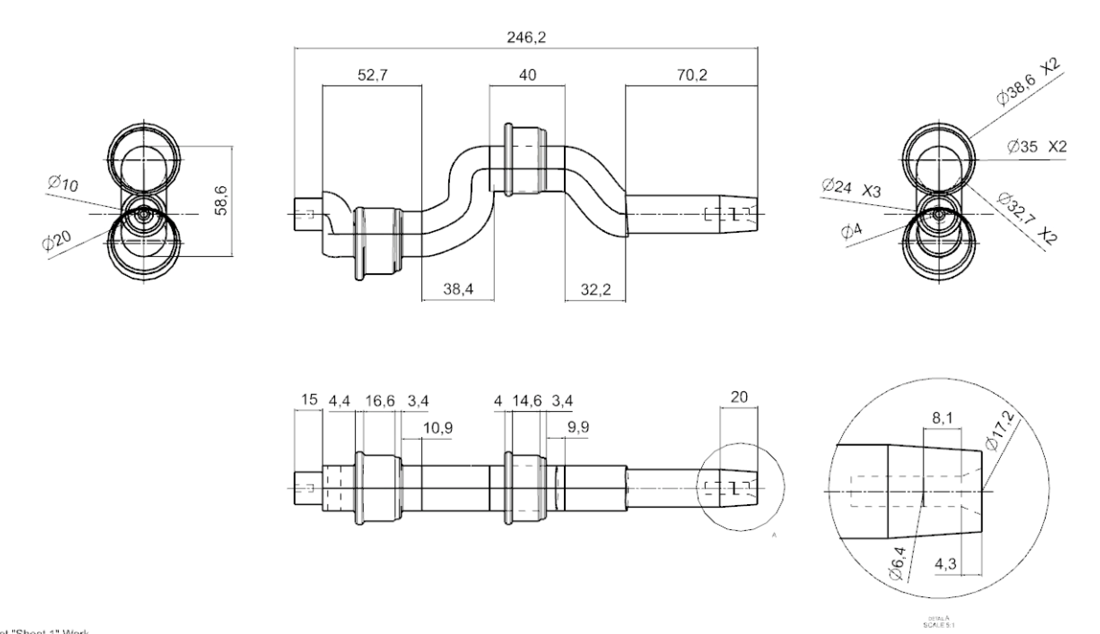

Slide 14
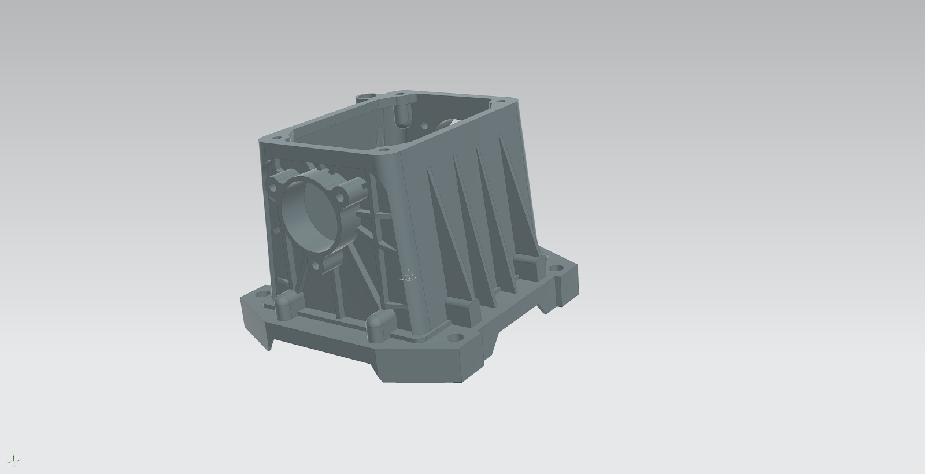
MODEL BY: HIKMET BATUHAN BALKI

Slide 15
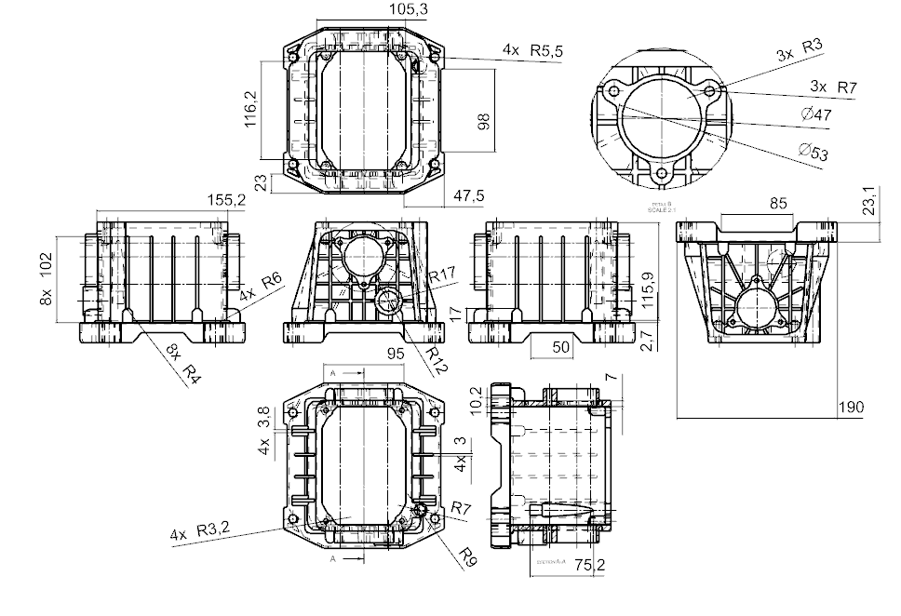

Slide 16
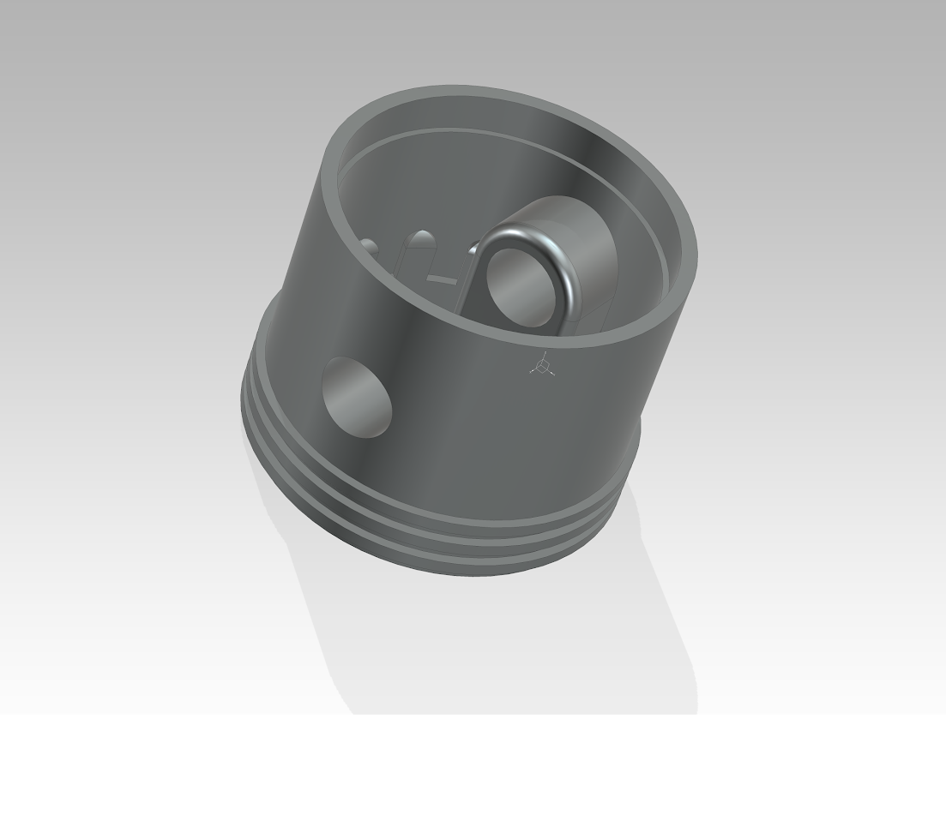
MODEL BY: HIKMET BATUHAN BALKI

Slide 17
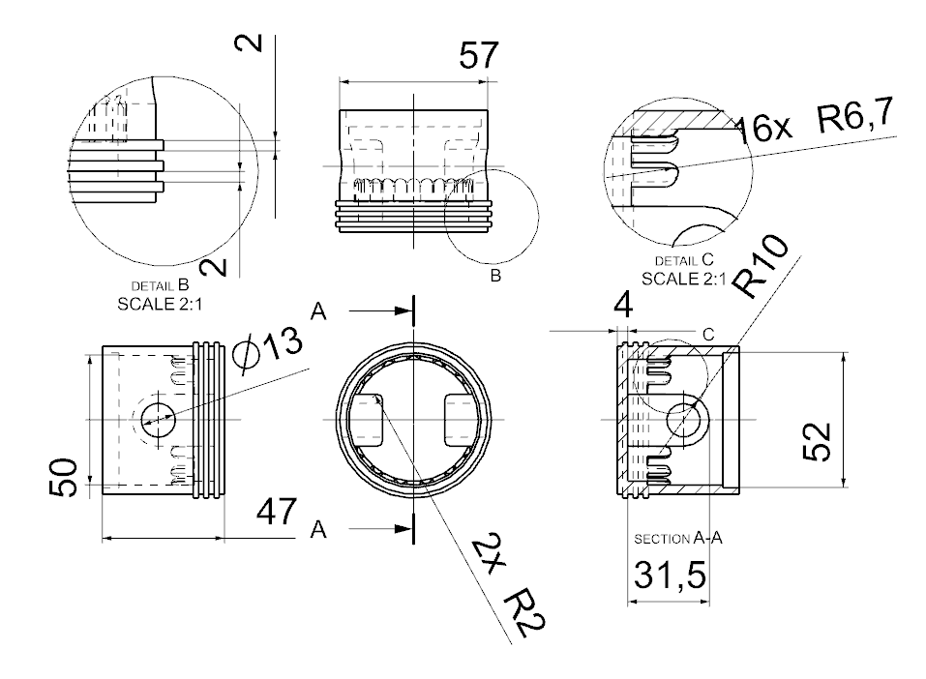

Slide 18
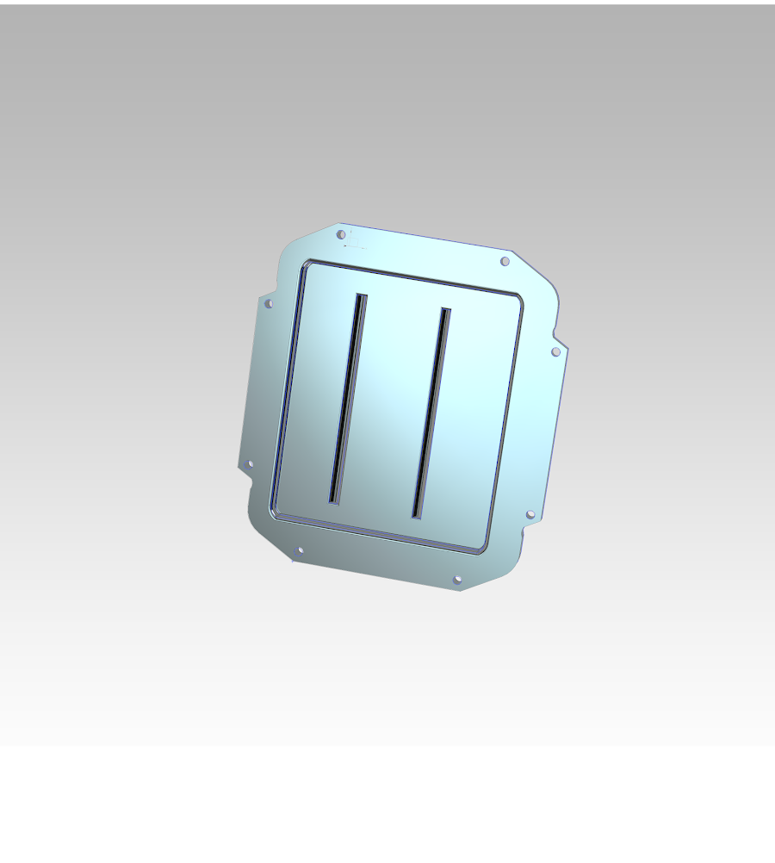
MODEL BY: AHMET METE COŞKUN

Slide 19
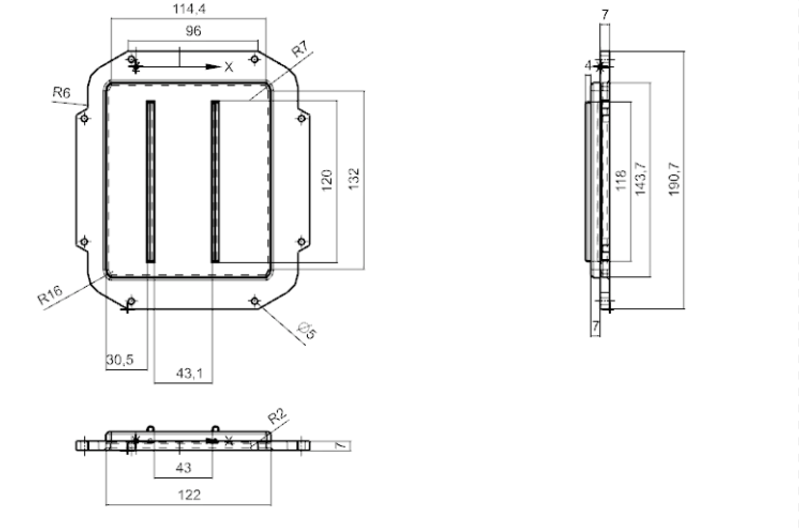

Slide 20
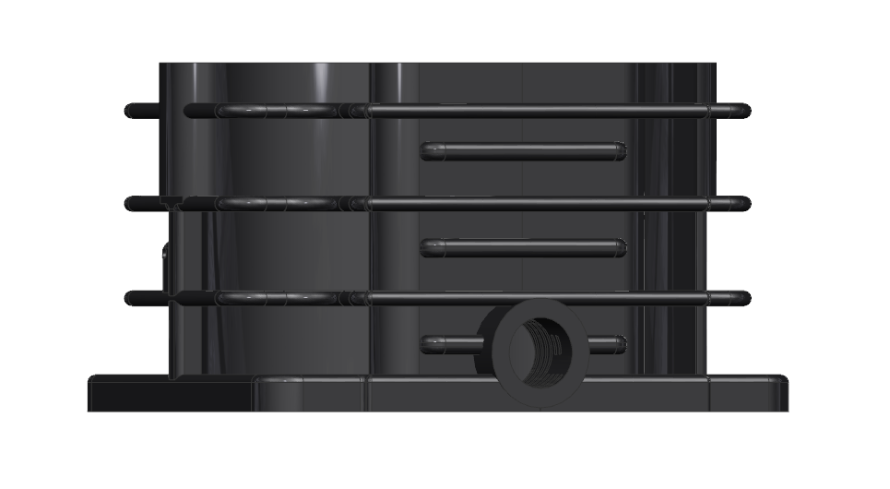
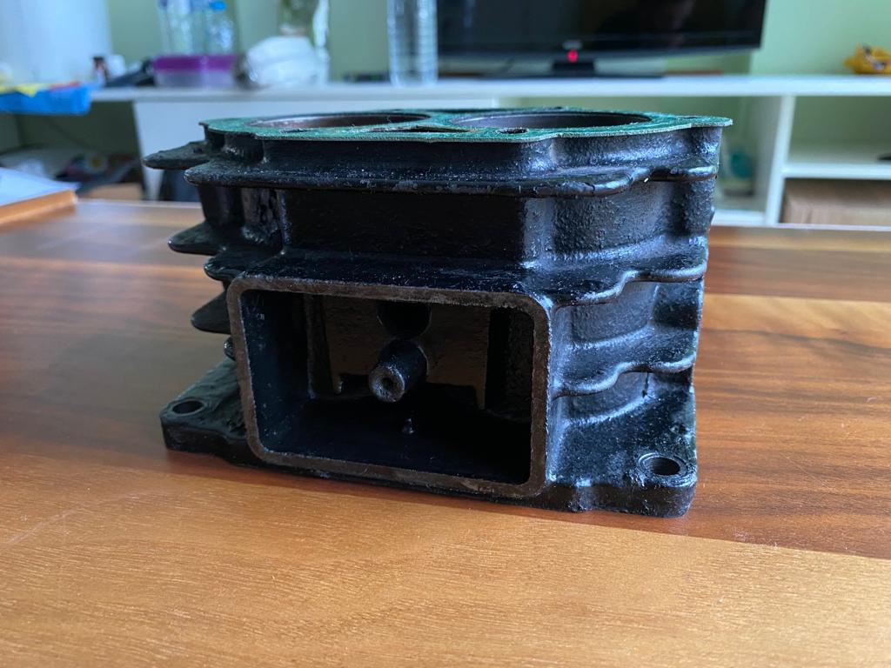
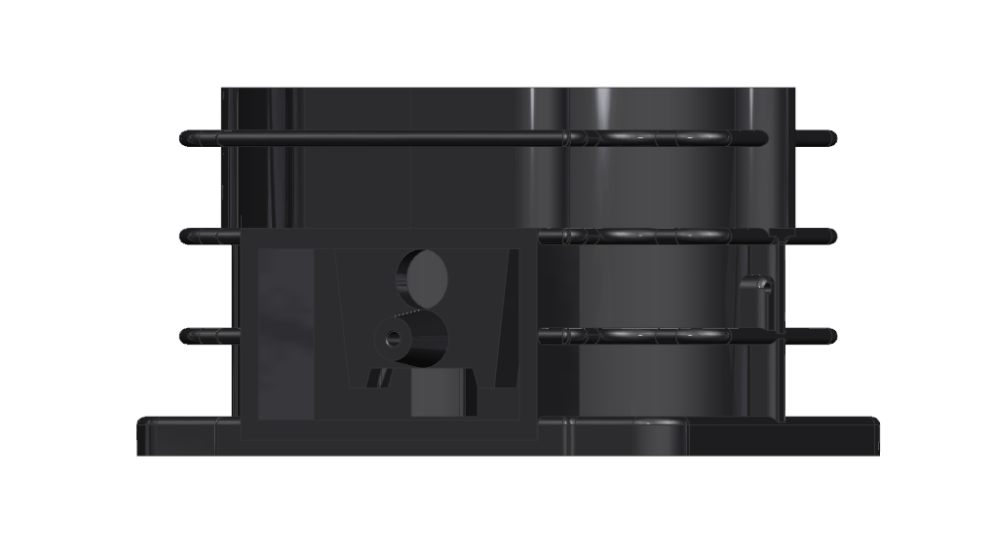
MODEL BY: mert ayhan tandoğdu

Slide 21
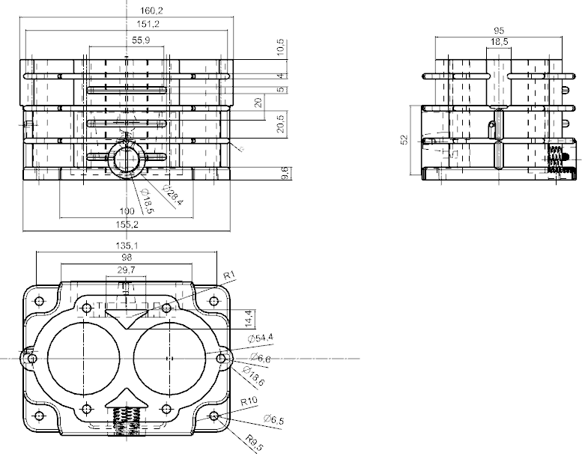
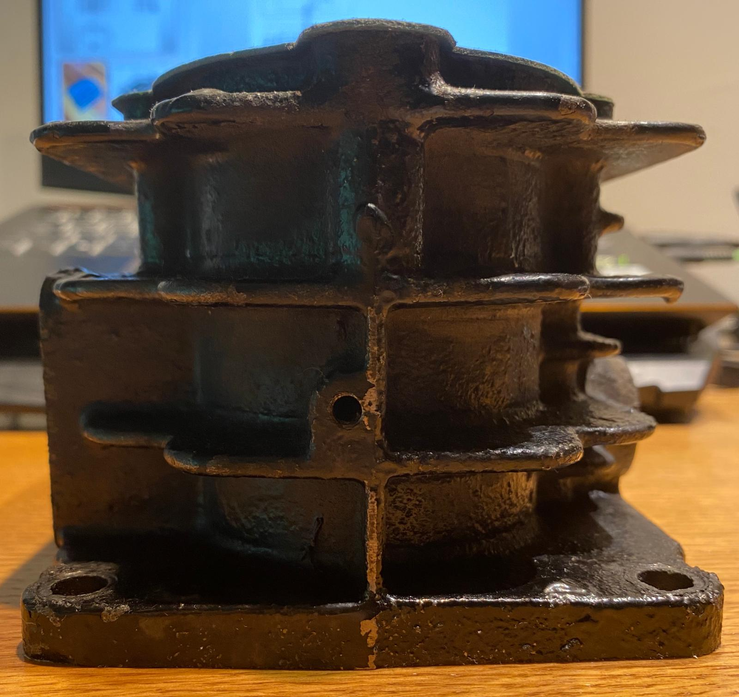

Slide 22
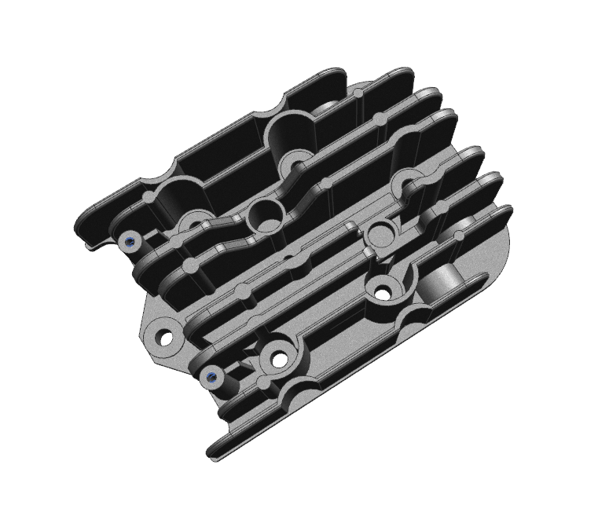
MODEL BY: mert ayhan tandoğdu

Slide 23
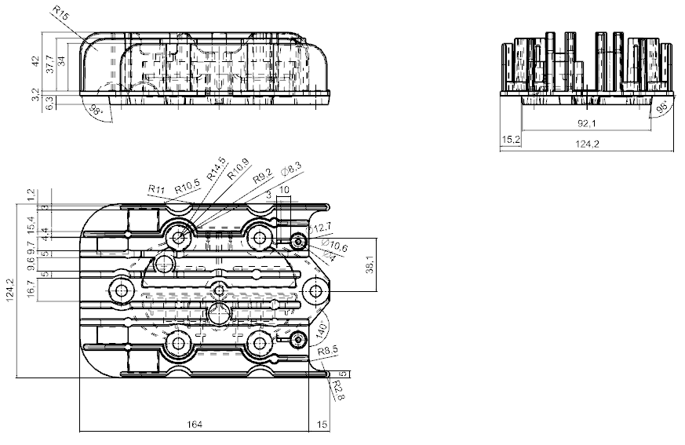
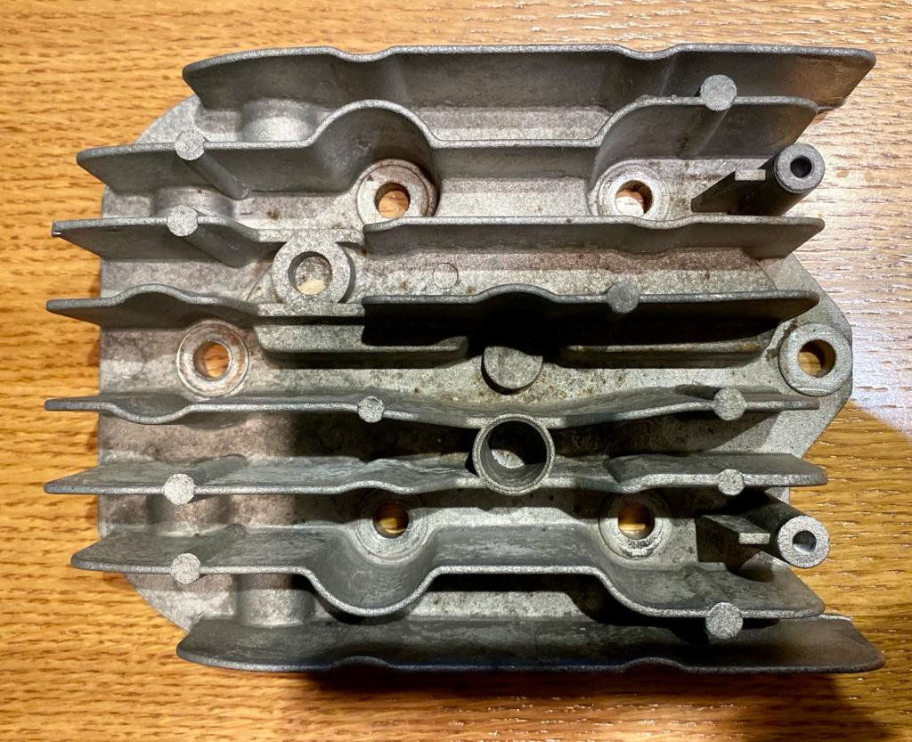

Slide 24
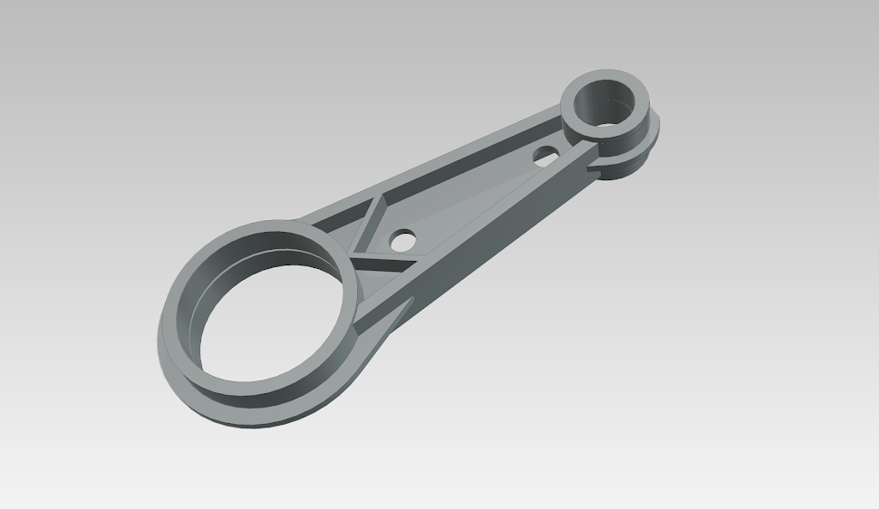
MODEL BY: ERKİN PÜREN

Slide 25
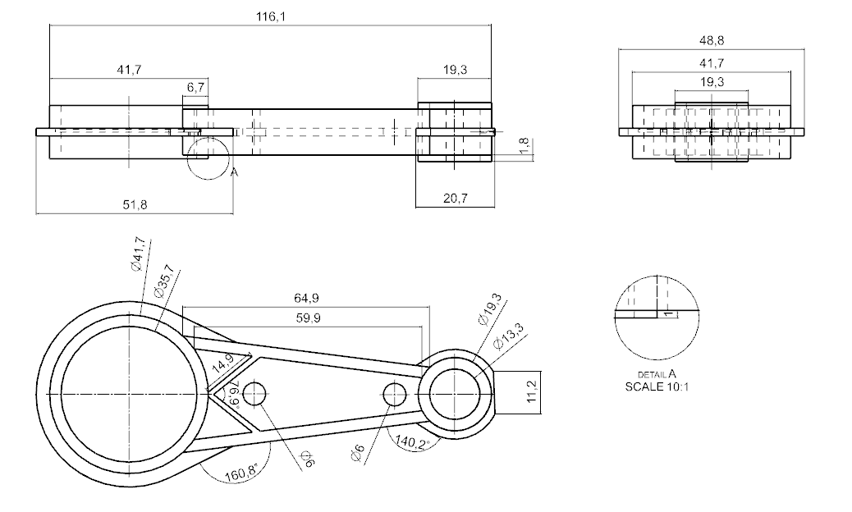

Slide 26
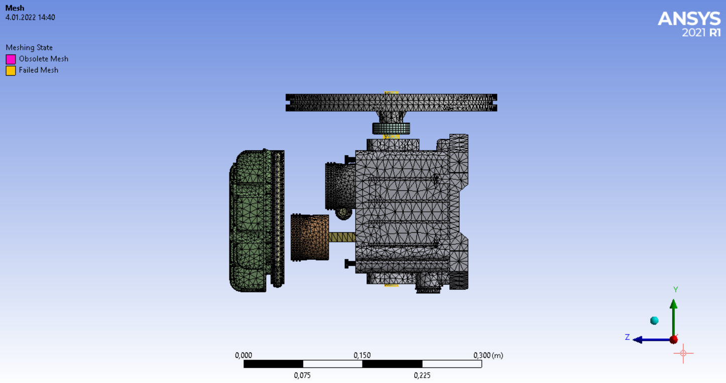
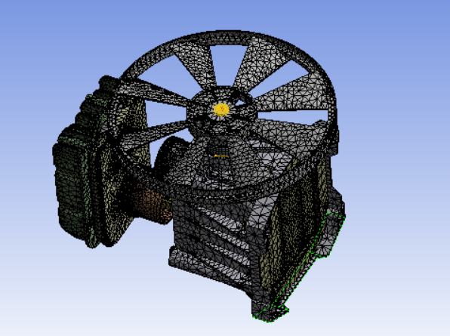
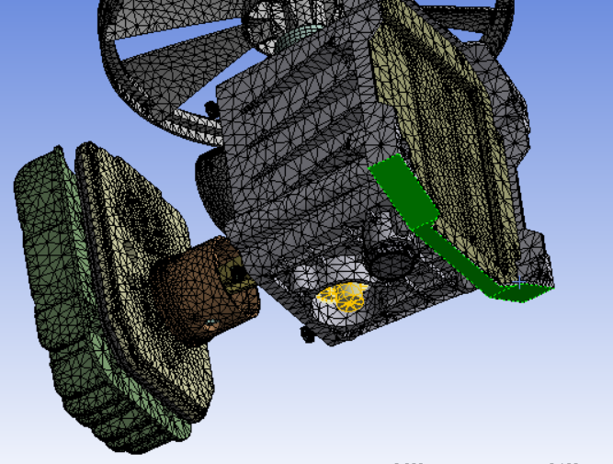
Fem structural analysıs
In thıs part, we meshed our geometry wıth mesh sıze 0,007 m. We fıxed the geometry on the bottom ends (-y dırectıon) by ıntroducıng parametrıcal forces. (We USED the weıght of the structure to get thıs gravıtatıonal force.) Later, wıth these forces, we ıncluded equıvalent stress (von-mıses) to observe where the stress wıll be hıgher. The hıgher stress poınts represents where our geometry can break.

Slide 27
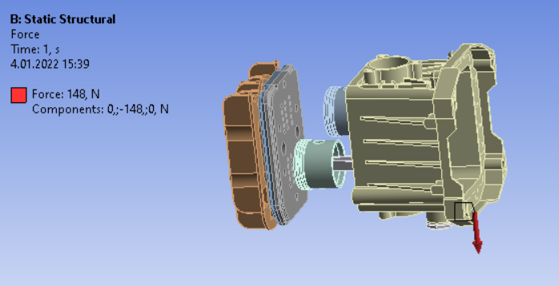
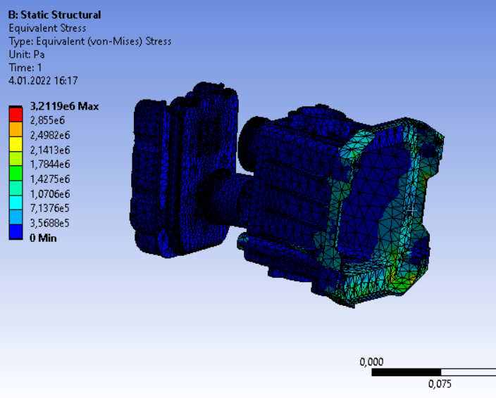
Problems we have faced:
Somehow ıt dıdn’t mesh geometry of the shaft ınsıde.
I always ended up gettıng under constraıned error whıch ı have solved wıth enablıng weak sprıng optıons on. Thıs error was because of ınsuffıcıent constraınt.

Slide 28
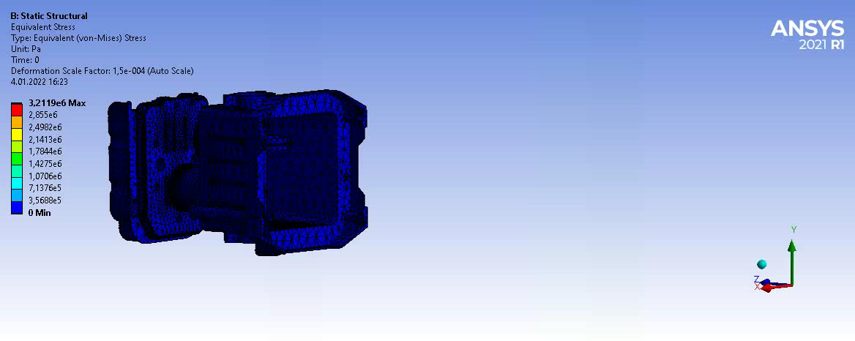
Results of fem
We have understood where our geometry may break – not due to the motıon but due to the surface where ıt sıts. It gets to 2 kpa where the bıggest stress factor occurs whıch ıs acceptable.

Slide 29
Commands we used
Revolve
edge blend extrude
copy sketch
MIrror
Hollow
SectIon surface
Boss

Slide 30
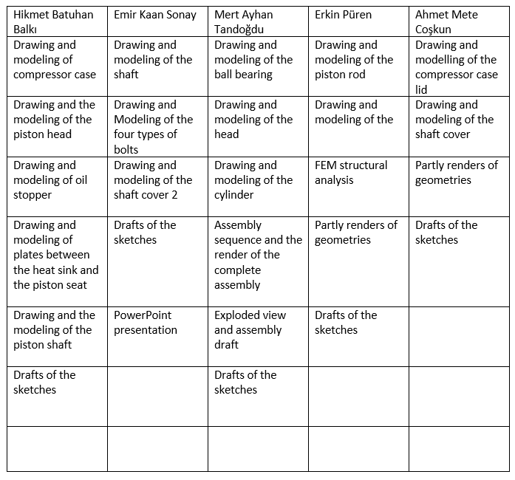

Slide 31
CONCLUSION

Slide 32
Resources
https://www.compressorworld.com/blog/aIr-compressors-and-how-they-work/
https://www.sonmezkompresor.com/pIstonlu-kompresor-nedIr-calIsma-prensIbI/
https://slIdetodoc.com/5-blm-kompresrler-sIkItIrma-nasIl-oluur-sktrma-akkan/

